Slide 1
ECE Additional Graduation Requirements
Earn a grade of C (2.0 GPA) or higher in MATH-170 and PHYS-170
Have a minimum cumulative GPA of C (2.0) in mathematics courses
Have a minimum cumulative GPA of C (2.0) in physics courses
No more than three grades below C (2.0) in Engineering Major Courses
You have to retake course/courses if you fail to satisfy the above

Slide 2
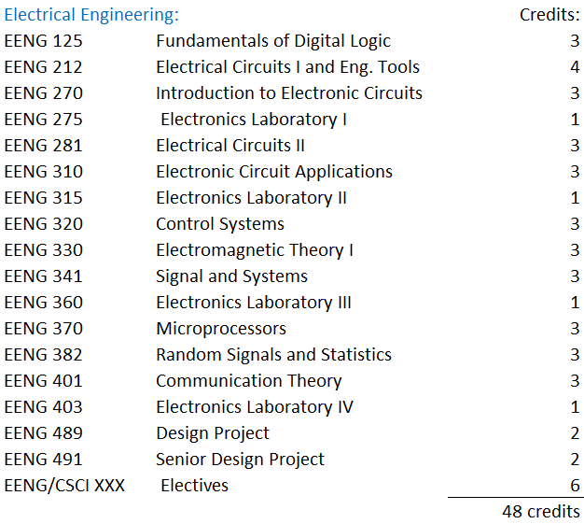
Engineering Major Courses

Slide 3
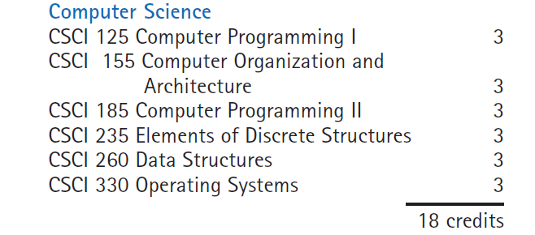
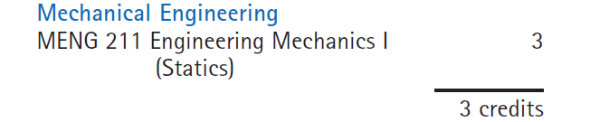
Engineering Major Courses

